Slide 1
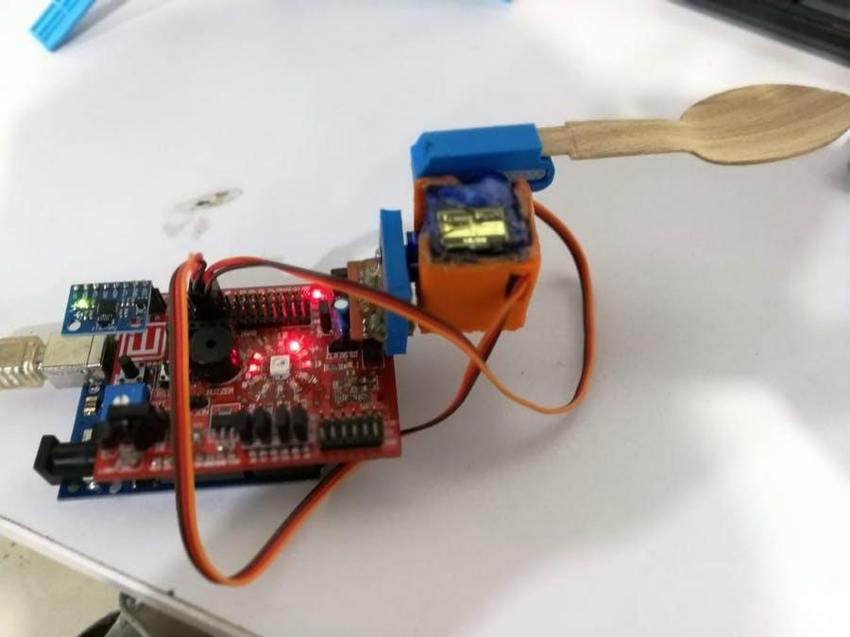
Assistive Spoon for Patients with Parkinson's

Slide 2

What is Parkinson's disease?
The symptoms of Parkinson's disease develop gradually. They often start with a slight tremor in one hand and a feeling of stiffness in the body.
Over time, other symptoms develop, and some people will have dementia.
Most of the symptoms result from a fall in dopamine levels in the brain.

Slide 3
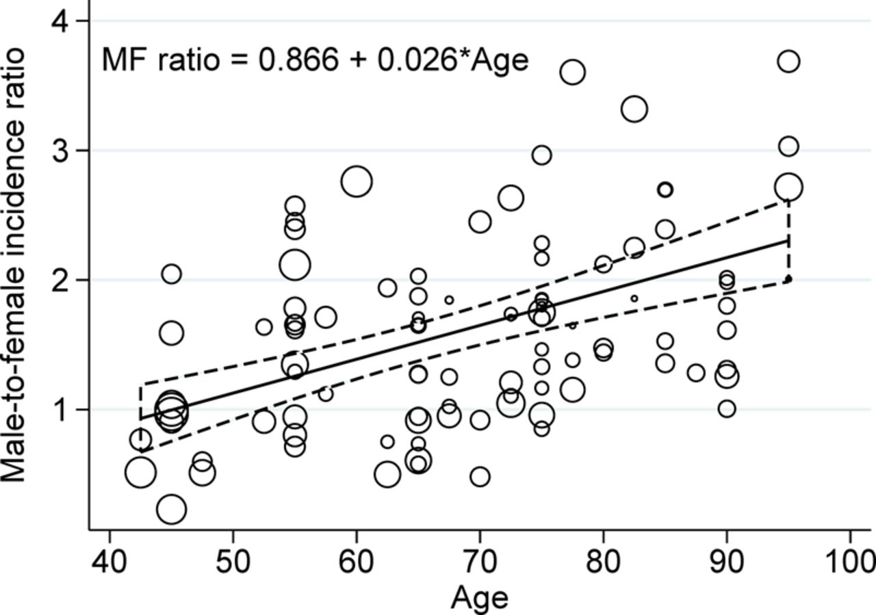
One study, based in France, found in 2015 that men are 50 percent more likely to develop Parkinson's disease than women overall, but the risk for women appears to increase with age.
In most people, symptoms appear at the age of 60 years or over. However in 5–10 percent of cases they appear earlier. When Parkinson's disease develops before the age of 50 years, this is called "early onset" Parkinson's disease.

Slide 4

One of the most important side effects of Parkinson's disease
One of the most troubling side effects of PD can be difficulty feeding oneself, perhaps the most basic of self-care tasks; trouble swallowing due to dysphagia can occur at any stage of the disorder. This can become quite serious, as difficulty with swallowing can lead to food or liquid getting in to the lungs; aspiration pneumonia is actually the leading cause of death in people with Parkinson’s Disease.
Sometimes the difficulty can be in merely being able to hold a utensil and direct food into the mouth due to tremors and the loss of fine motor skills and control.

Slide 5
Project Idea
The goal of our project was to be able to understand what are the system dynamics and leanings which can be accrued by building a similar project with off the shelf components.
.
The design was expected to be held in hand and be able to help cancel out any tremors the person's hand felt, thus providing the ability to level and steady out a spoon

Slide 6
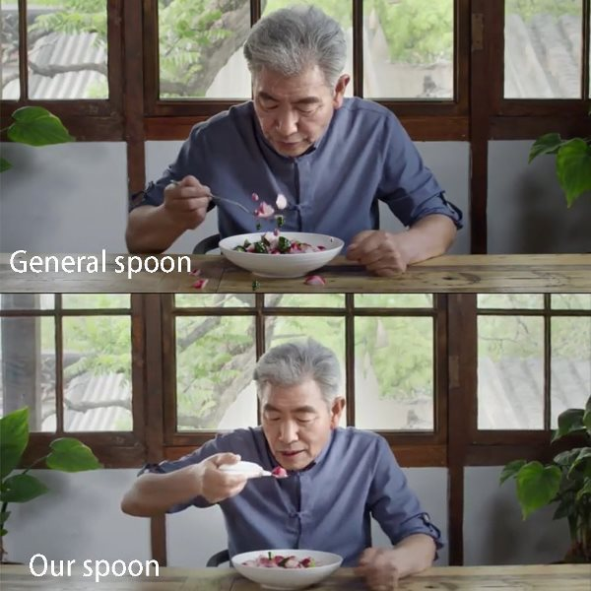
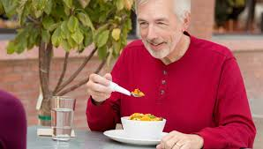
The most important objectives of the project

Slide 7
Being able to eat unaided is a huge issue for people with Parkinson’s Disease. Assistive tools like these spoons can give people back a much-needed sense of self-sufficiency and safety. Not only that, being able to eat in public without embarrassment or fear is hugely helpful in maintaining a sense of dignity and confidence, and avoiding the isolation and depression that so all-too-often accompany a progressive illness.

